Slide 1
What's better traditional or online education?

Slide 2

Group Members:
Nafinur Leo
Mumtarin Hossain Siam
Md Fardin Ahosan Sakib
Abu Jubair Bin Amin
Romona Magdalene Sarkar

Slide 3

OUTLINES:
1.What is traditional education.
2.What is online education.
3.What's the benefit of both.
4.Which is better and why?
5.Conclusion.

Slide 4

What is traditional education
Traditional education is also known as basics , conventional education.
Some form of education reform promote the adopting progressive education practices.
Traditional education is associated with much stronger elements.

Slide 5

What is online education
Online education is a technique of learning.
Getting training and conducting research that involves electronic media and techniques

Slide 6

What's the benefit of Traditional education and online Education
Traditional education:
Face to face communication
It can be completed in less duration
Online education:
Gives you more flexibility.
Self-discipline and responsibility

Slide 7
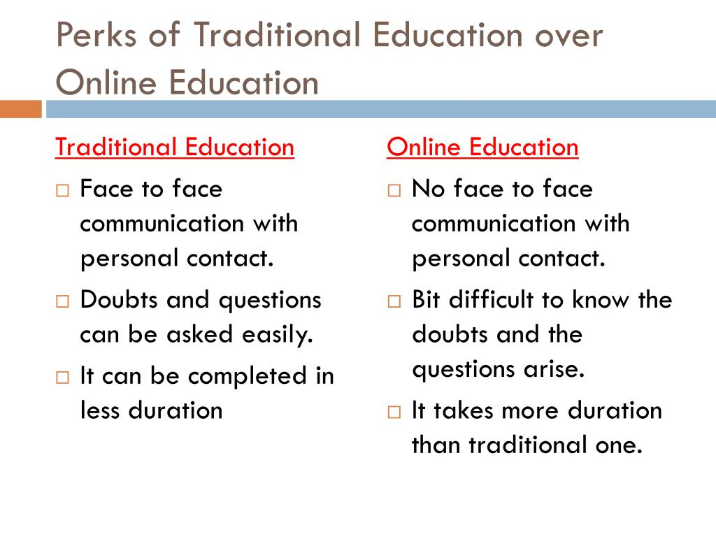
Which is better and why?
Traditional Education:
Interaction and communication.
Scheduled learning.
Social benefits.

Slide 8

Conclusion:
Both the education systems has got
advantages as well as disadvantages.
You can choose the best for you according to your convenience and suitability!

Slide 9

THANK YOU

